Slide 1
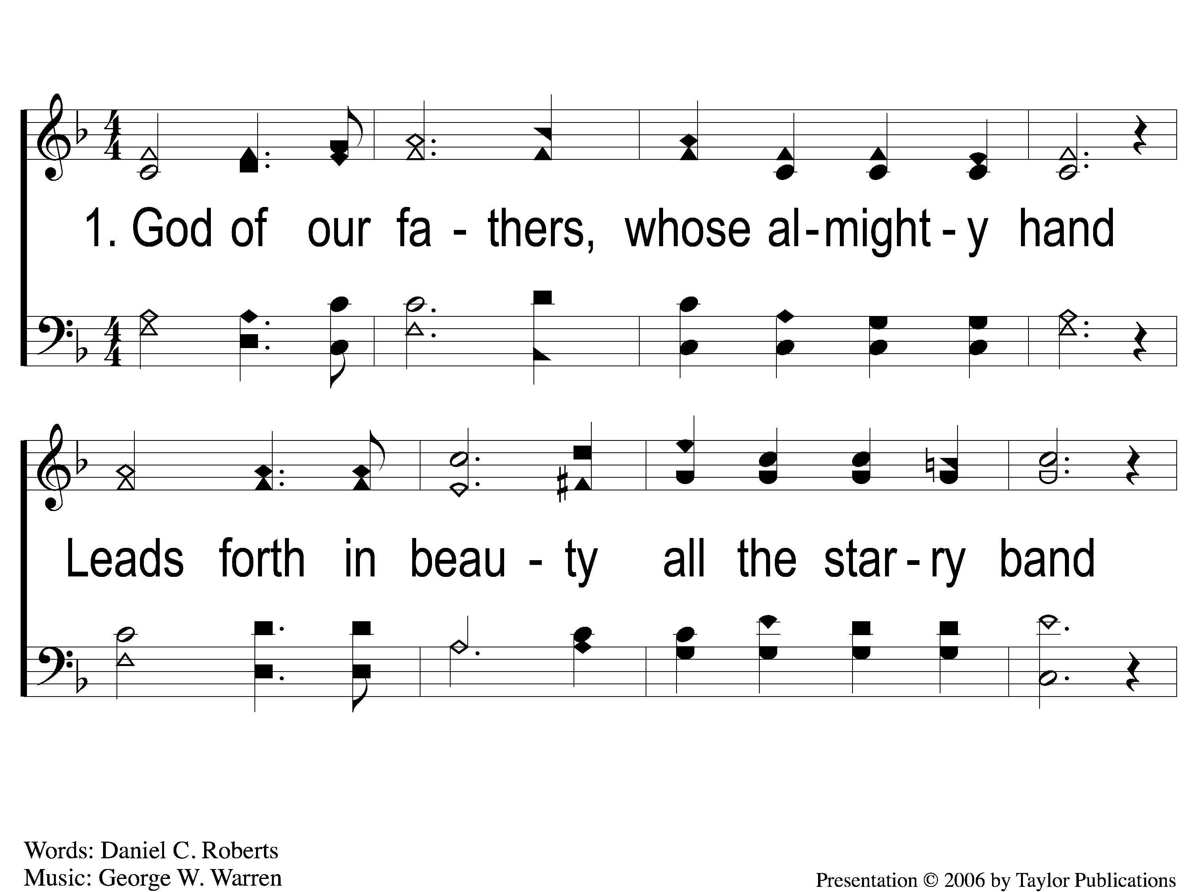
1-1 God of Our Fathers
God Of Our Fathers
139

Slide 2
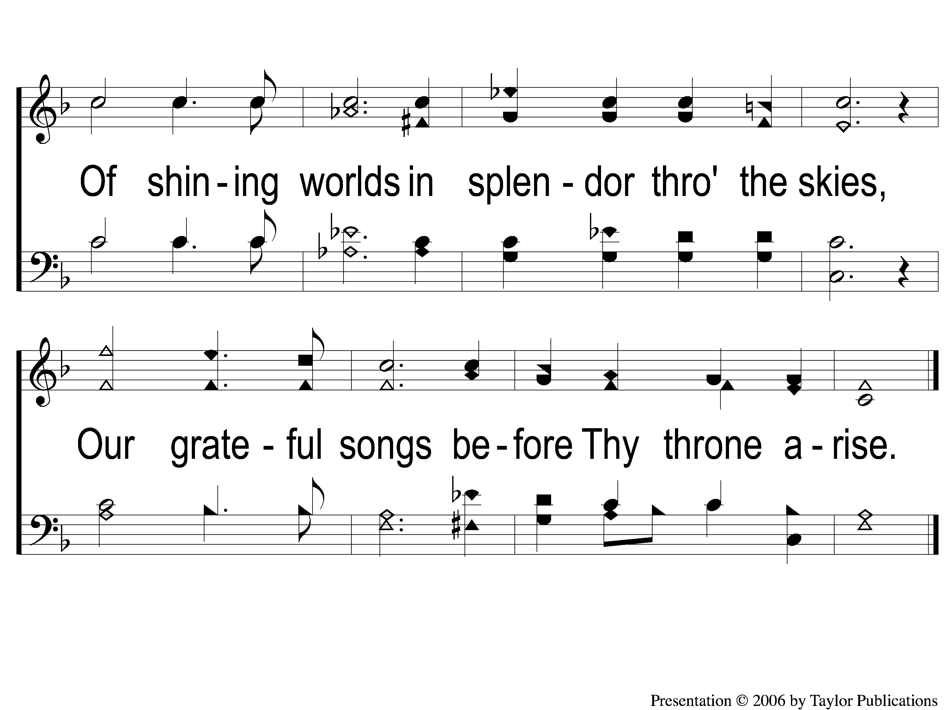
1-2 God of Our Fathers
God Of Our Fathers
139

Slide 3
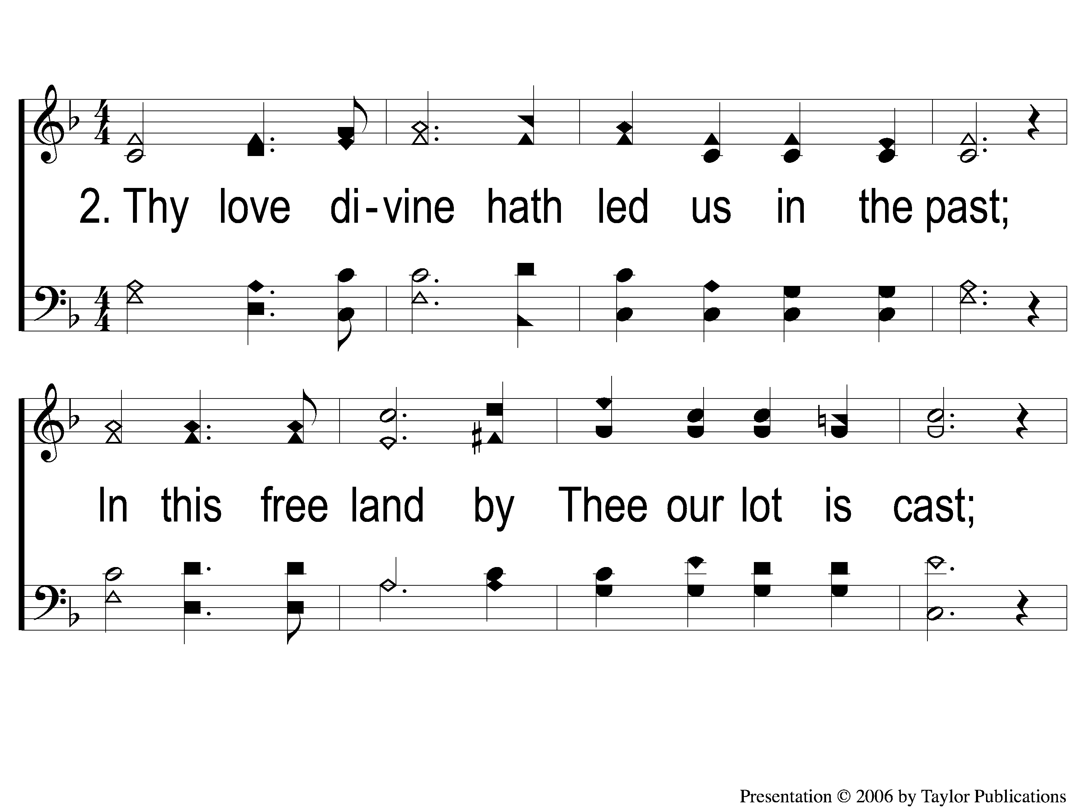
2-1 God of Our Fathers
God Of Our Fathers
139

Slide 4
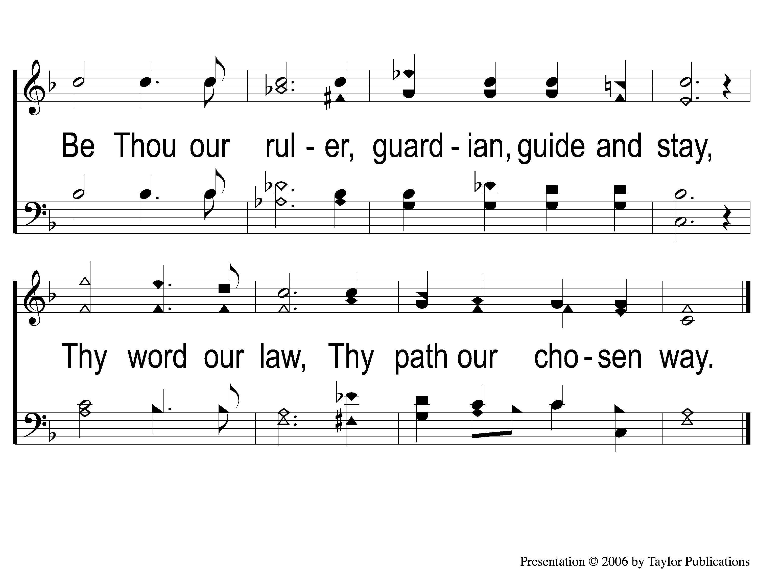
2-2 God of Our Fathers
God Of Our Fathers
139

Slide 5
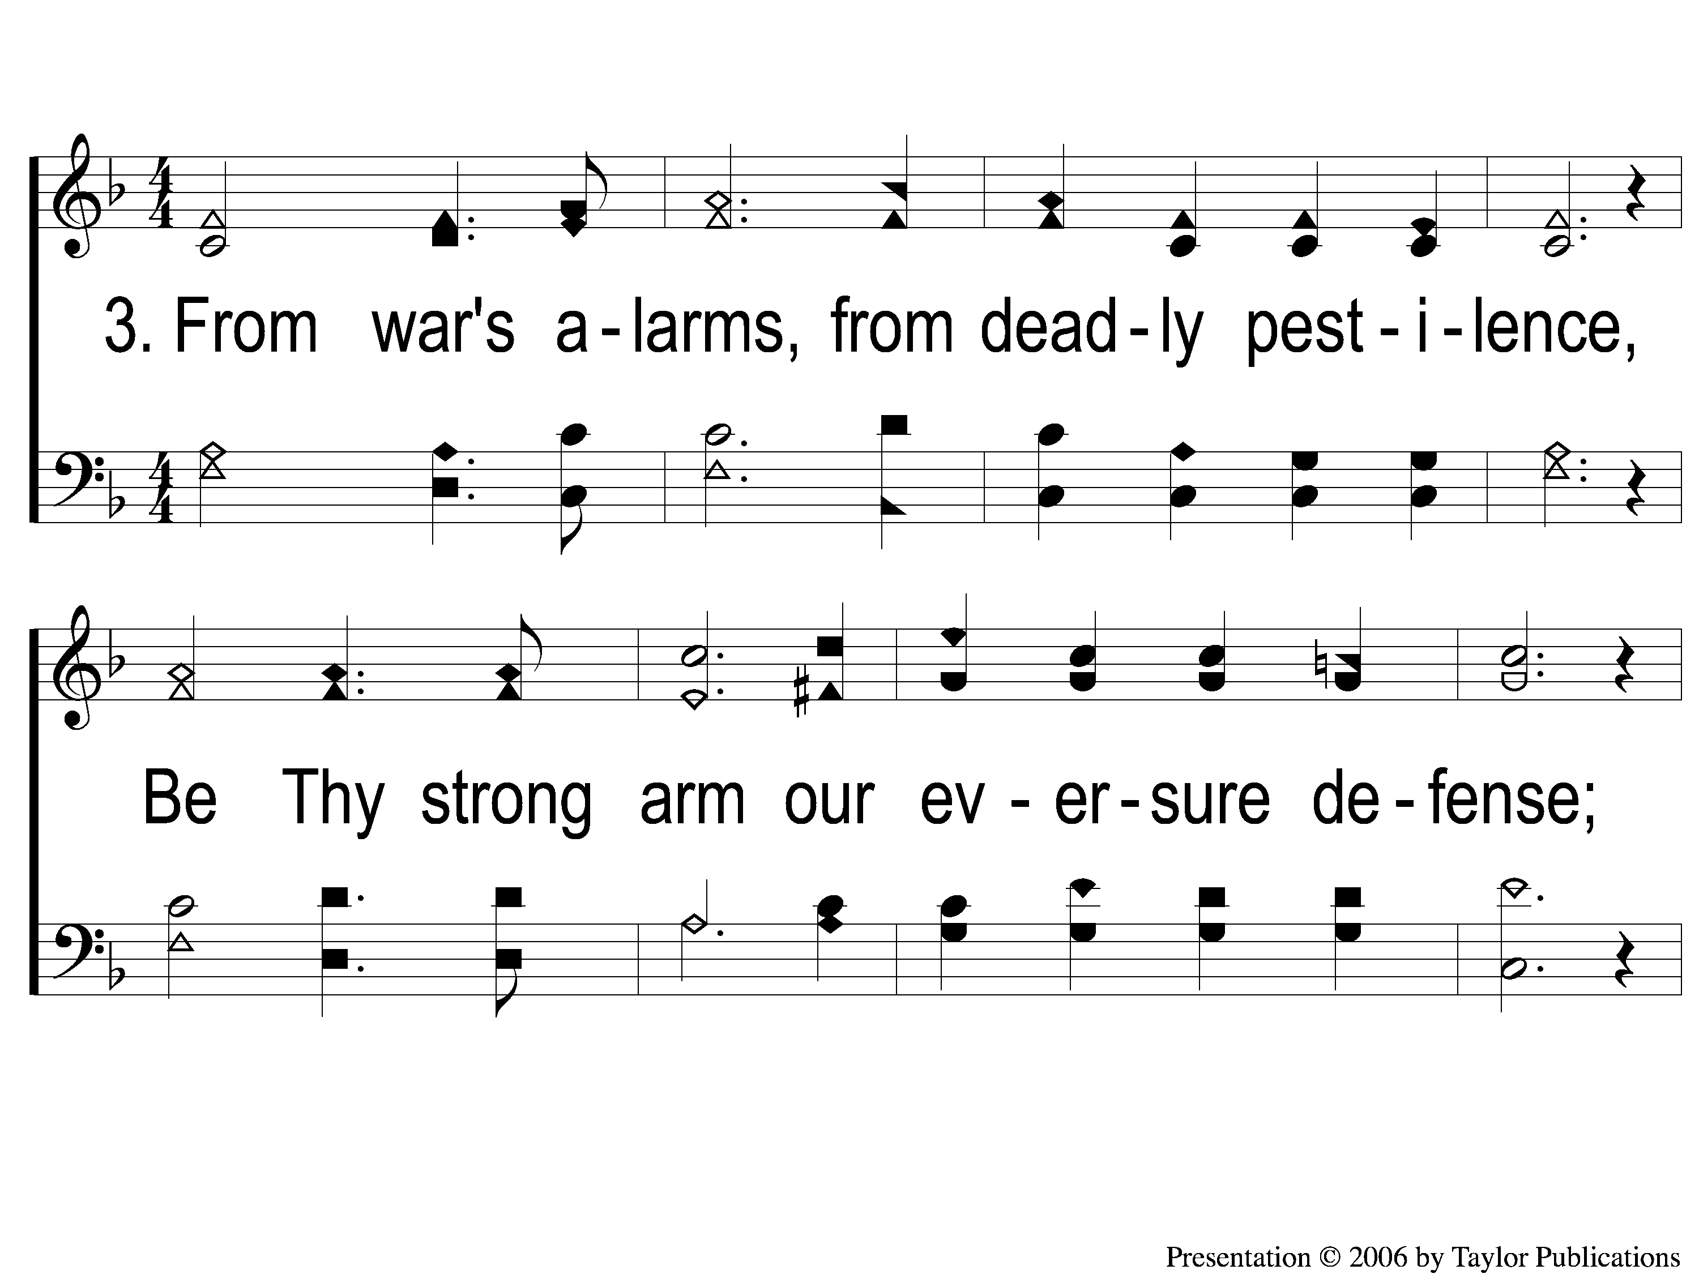
3-1 God of Our Fathers
God Of Our Fathers
139

Slide 6
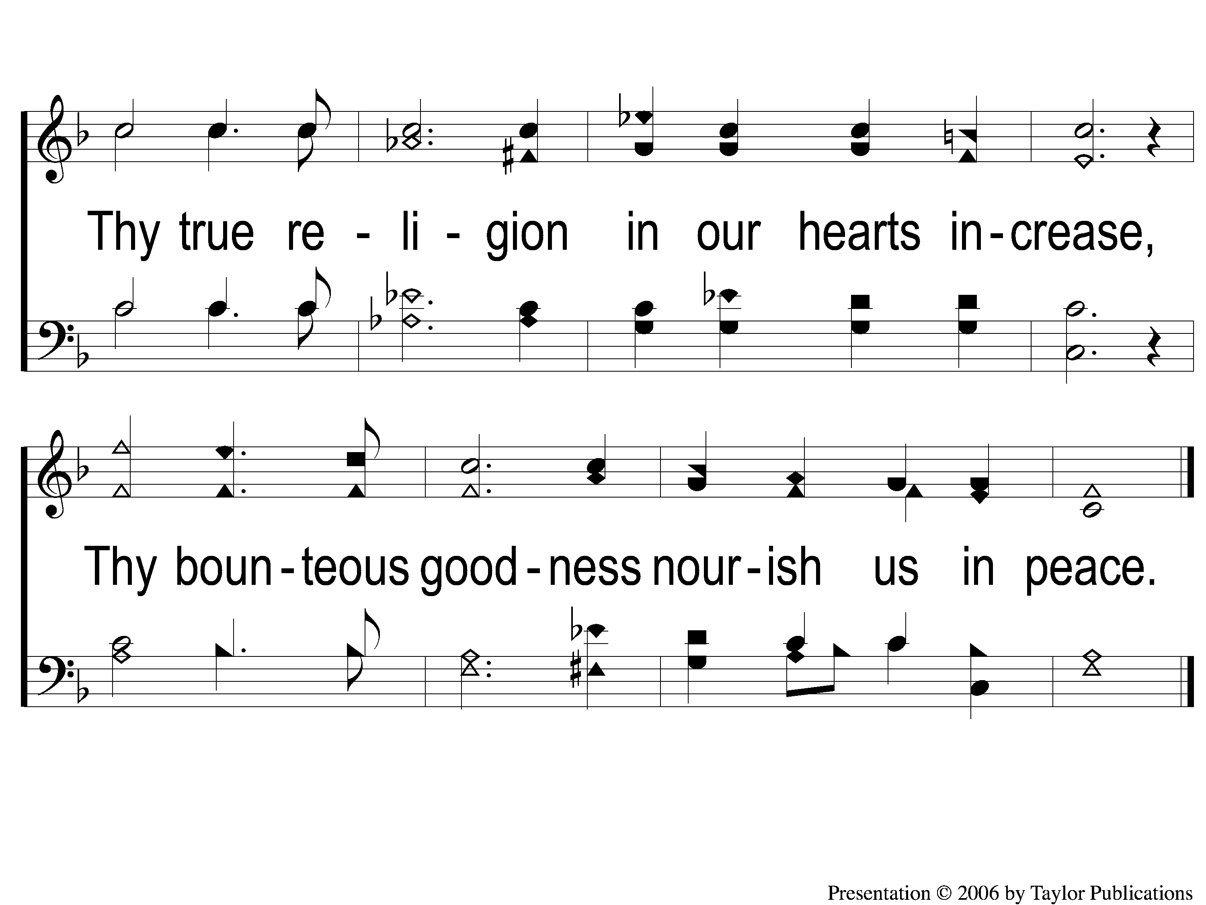
3-2 God of Our Fathers
God Of Our Fathers
139

Slide 7
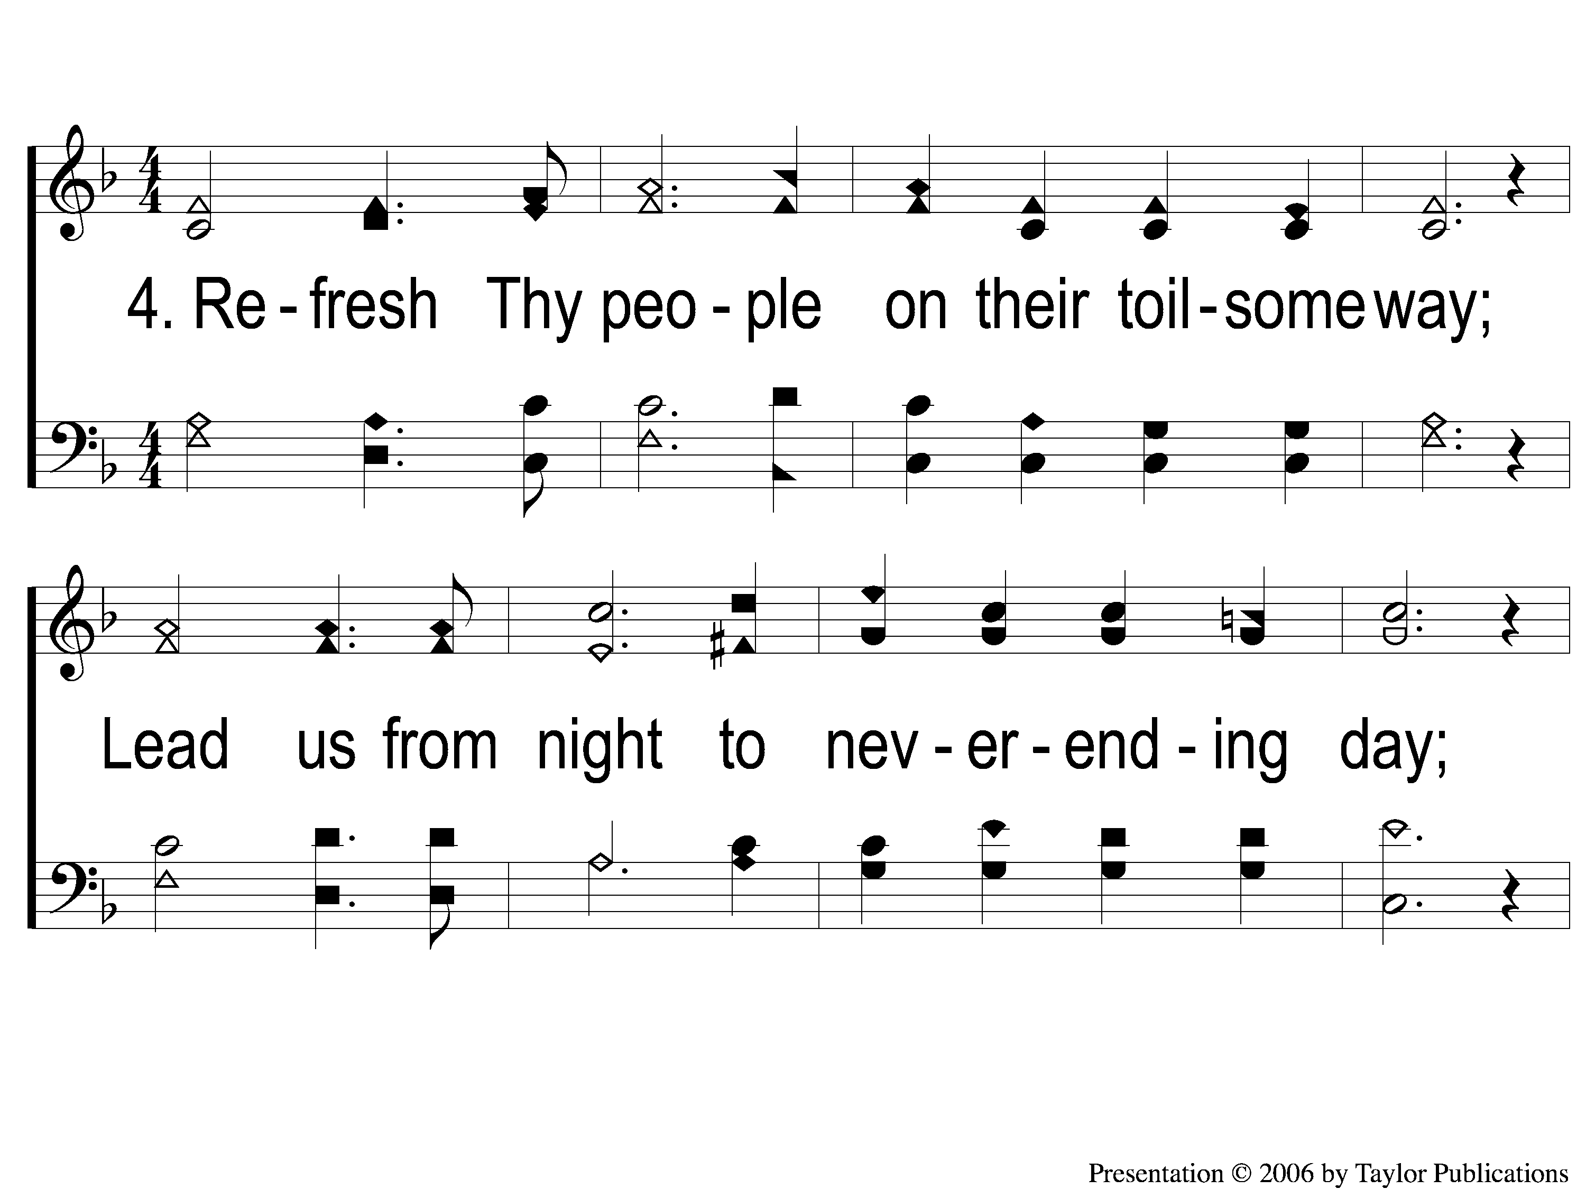
4-1 God of Our Fathers
God Of Our Fathers
139

Slide 8
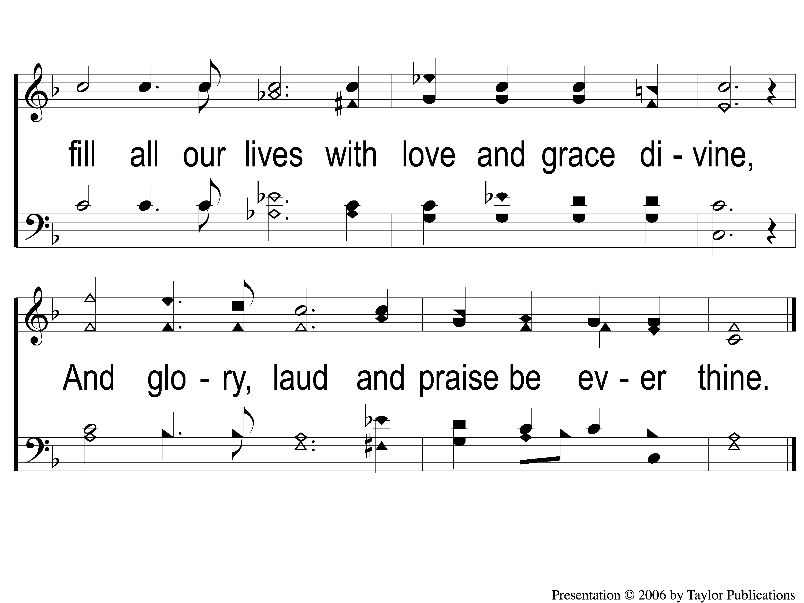
4-2 God of Our Fathers
God Of Our Fathers
139

